Slide 1
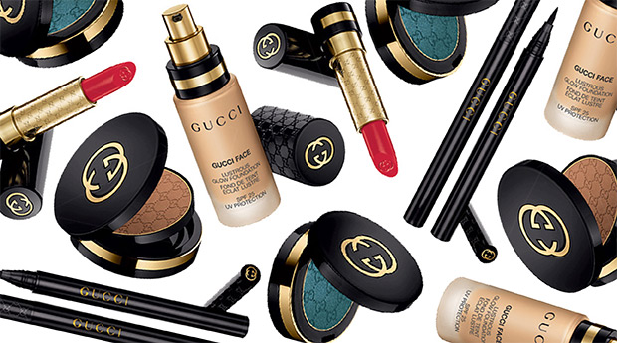
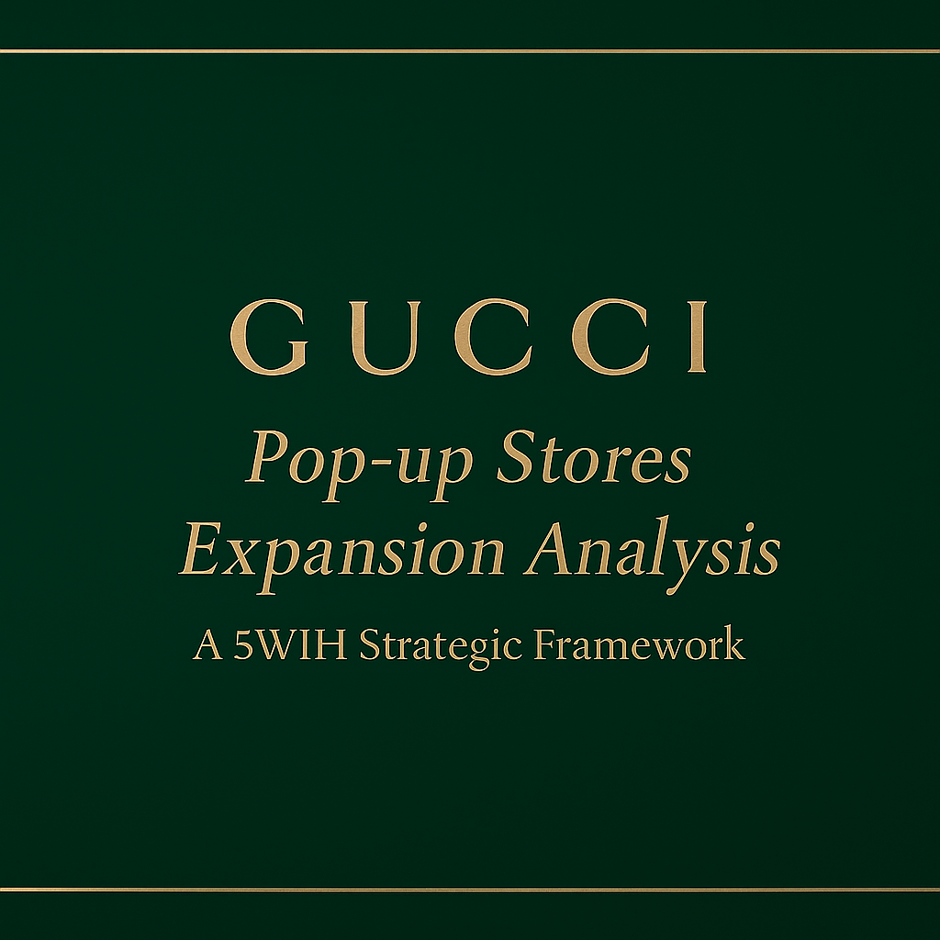
Gucci Pop-up Cosmetics Expansion Analysis A 5W1H Strategic Framework
Marketing Team
Karina Hsu
Notes:
When you hear the name Gucci, the first things that come to mind are fashion, handbags, and high-end luxury. However, not many people associate Gucci with cosmetics.

Slide 2
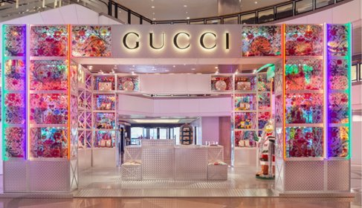
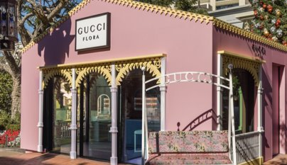
What is POP UP store - Overview
POP-UP store concept offere immersive, limited-time brand experiences and exclusivity.
For Gucci, pop-ups act as a strategic tool to test markets, showcase craftsmanship, and build emotional connections.

Slide 3
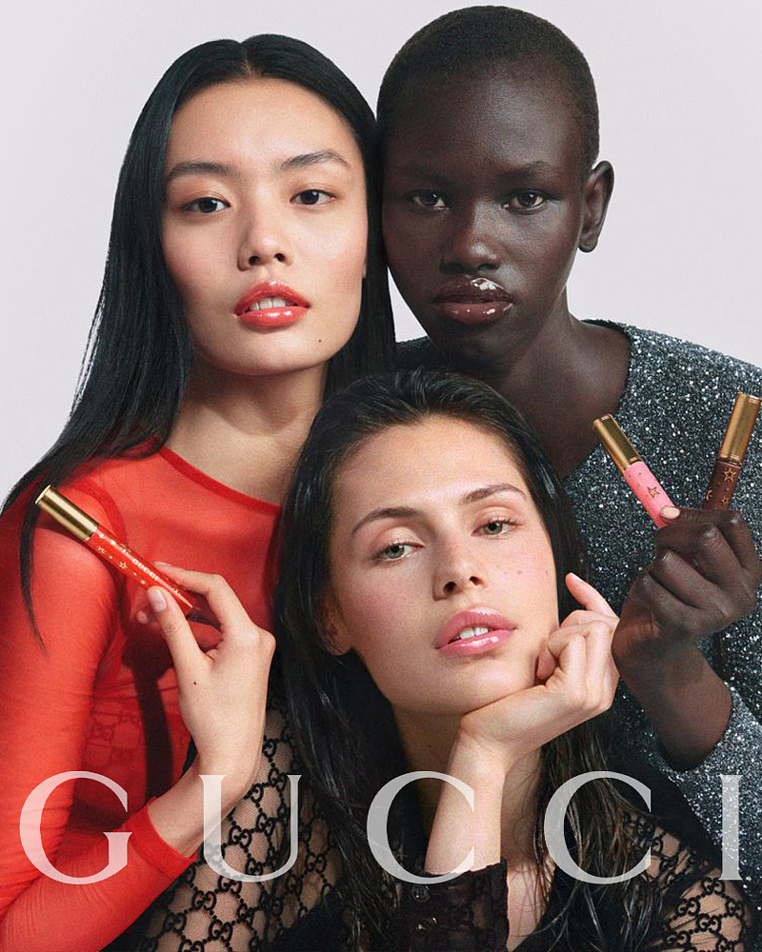
AGENDA
Why - Gucci expansion rationale
Where - Regional performance
When - Seasonality trends
Who - Competitive landscape
What - Product strengths
How - Event strategy recommendations
Notes:
We use the 5W1H framework to explain Gucci’s pop-up store strategy.
We’ll start with Why — to understand why Gucci should invest in pop-up stores and how this can help grow its beauty business.
Then Where — to see which regions or cities show the best sales and conversion performance.
When looks at the seasonal trends — when is the best time to launch pop-ups.
Who analyzes the competitors, so we can define Gucci’s position in the luxury beauty market.
What focuses on the product categories that perform the best and bring the highest impact.
And finally, How — the event strategies and recommendations for Gucci’s future pop-ups.

Slide 4
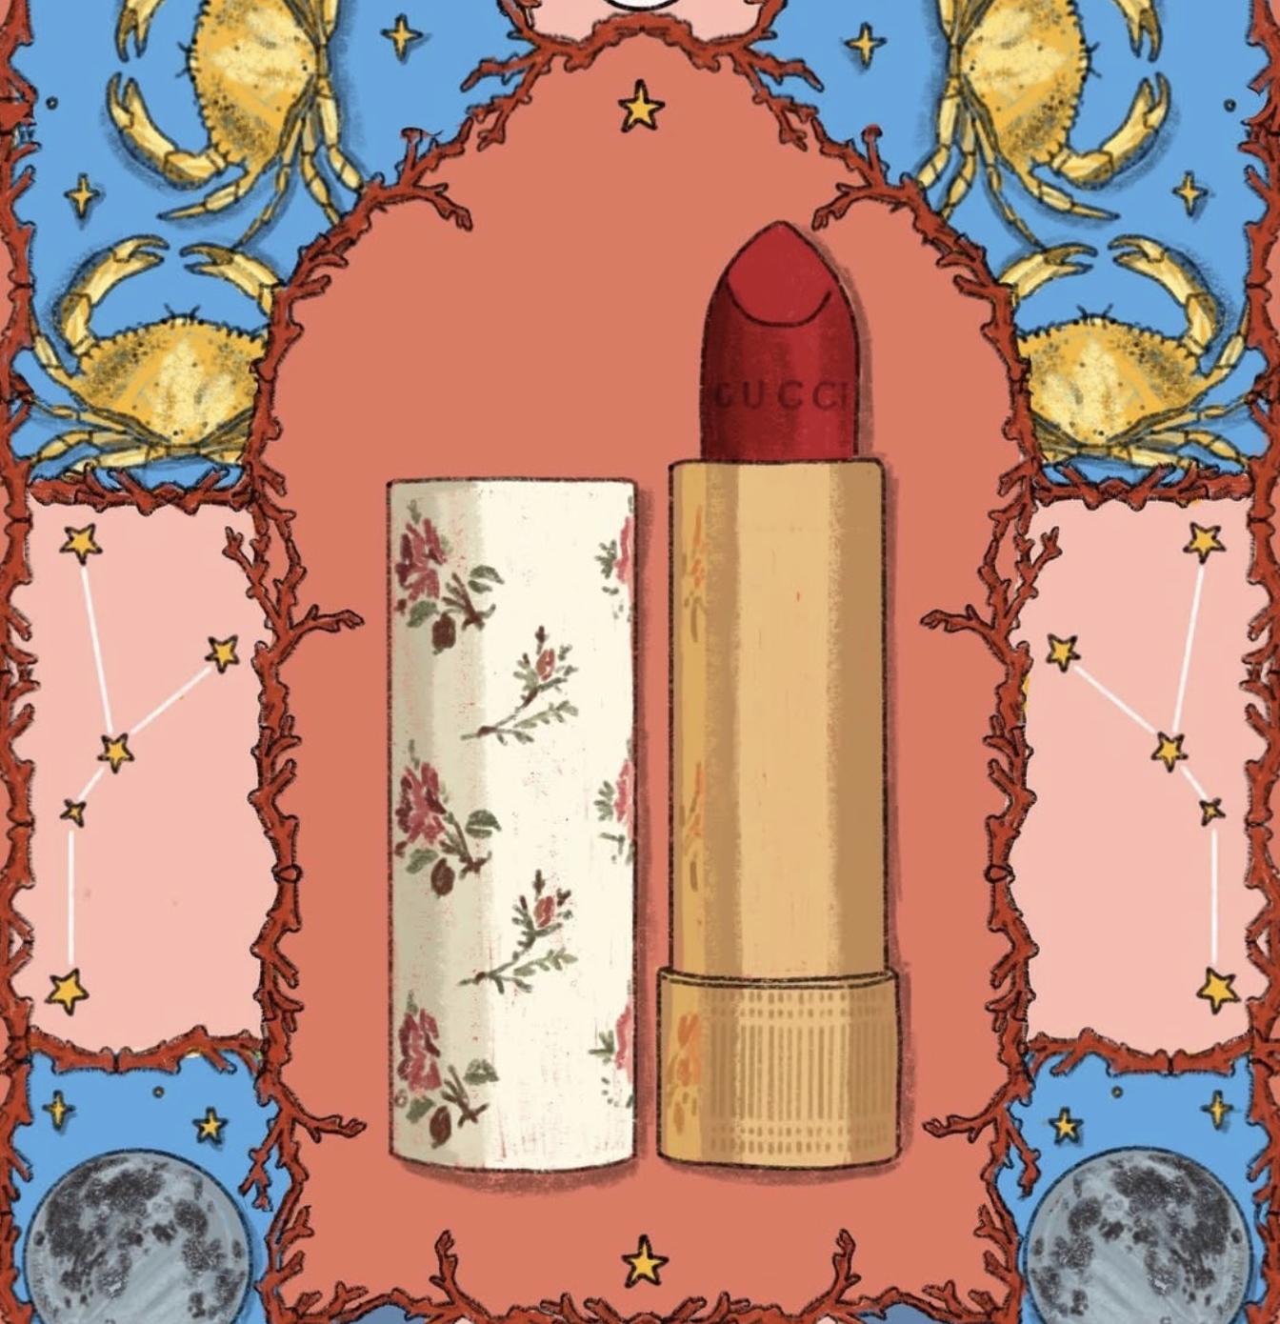
Why?
Boost Brand Visibility
Experience Luxury
Drive Sales and Trial
Market Testing
Content and PR Value
Notes:
Gucci Beauty remains underexposed compared to its dominant fashion and leather segments. Expanding pop-up stores can elevate brand visibility, attract new consumers, and strengthen Gucci’s position in luxury beauty.
Boost Brand Visibility: Creates buzz and awareness for GucciBeauty in high-footfall, trend-forward locations.
Experience Luxury: Lets customers test, feel, and experienceproducts in an immersive Gucci environment.
Drive Sales & Trial: Encourages product sampling and impulsepurchases for new or limited-edition launches.
Market Testing: Helps Gucci analyze regional demand andconsumer preferences before wider rollouts.
Content & PR Value: Generates social media engagement andmedia coverage through visually striking setups.

Slide 5
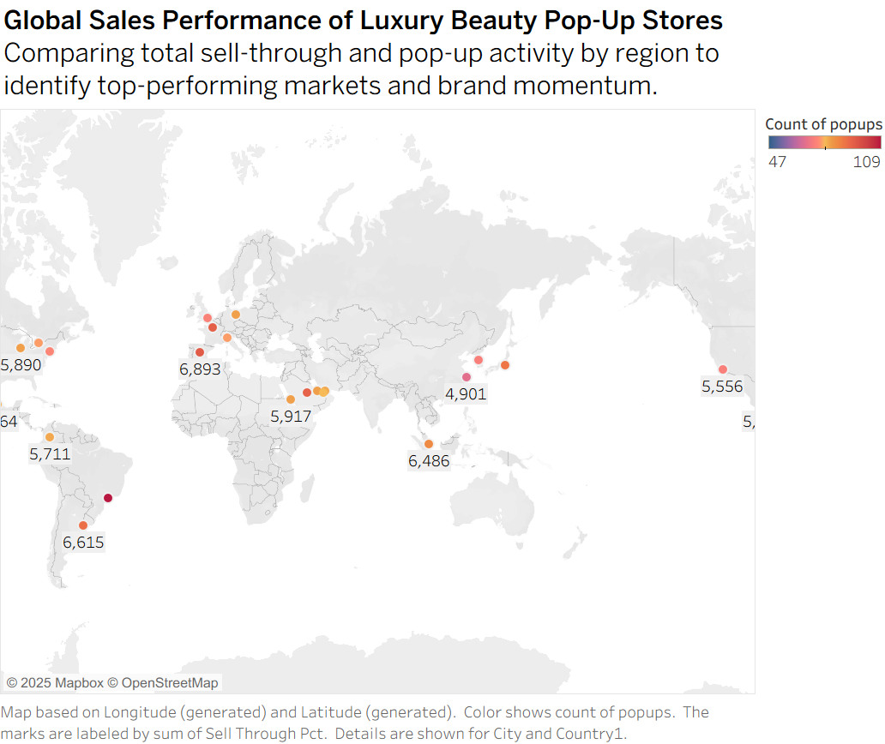
Why?

Slide 6
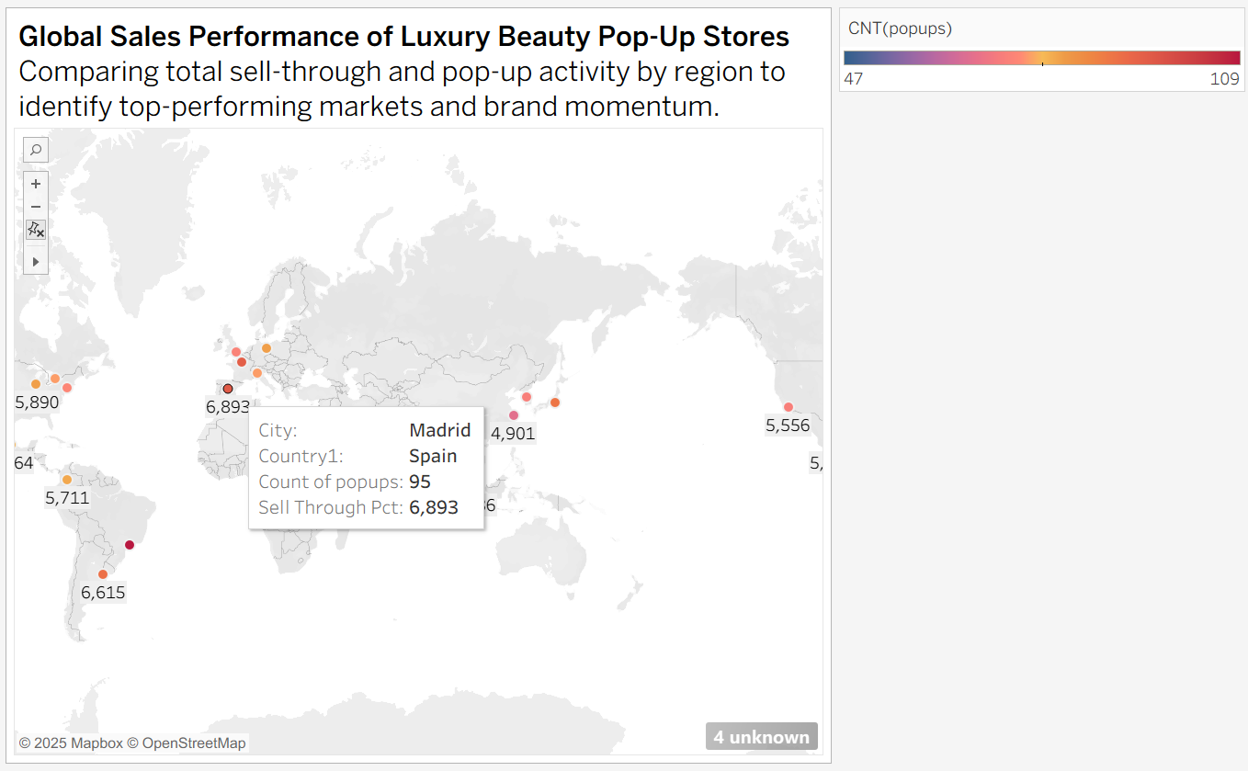
Why?

Slide 7
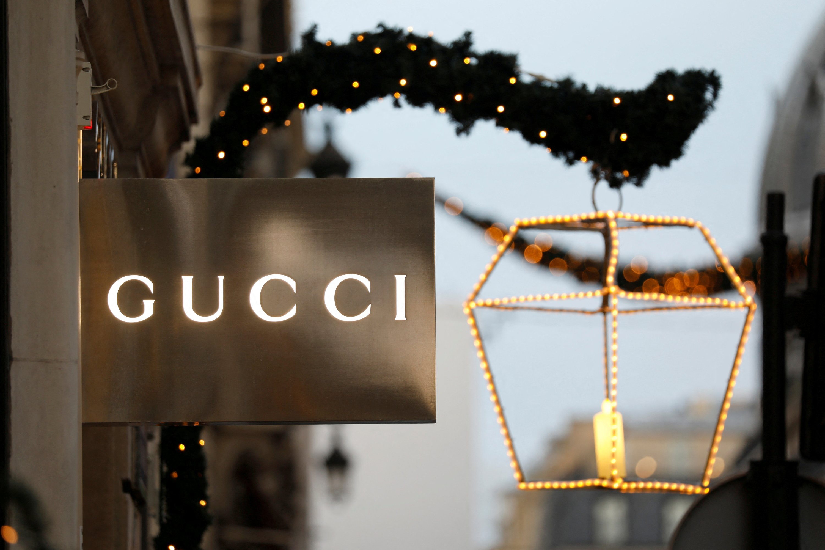
Where?
Top Performing Regions
High-Potential Markets
Regional Insights
Notes:
Top Performing Regions & Cities: Identify areas with strongestsales and sell-through rates.
High-Potential Markets: Target regions showing strong demandfor beauty and luxury experiences.
Regional Insights: Analyze how local preferences impactconversion rates and engagement levels.

Slide 8
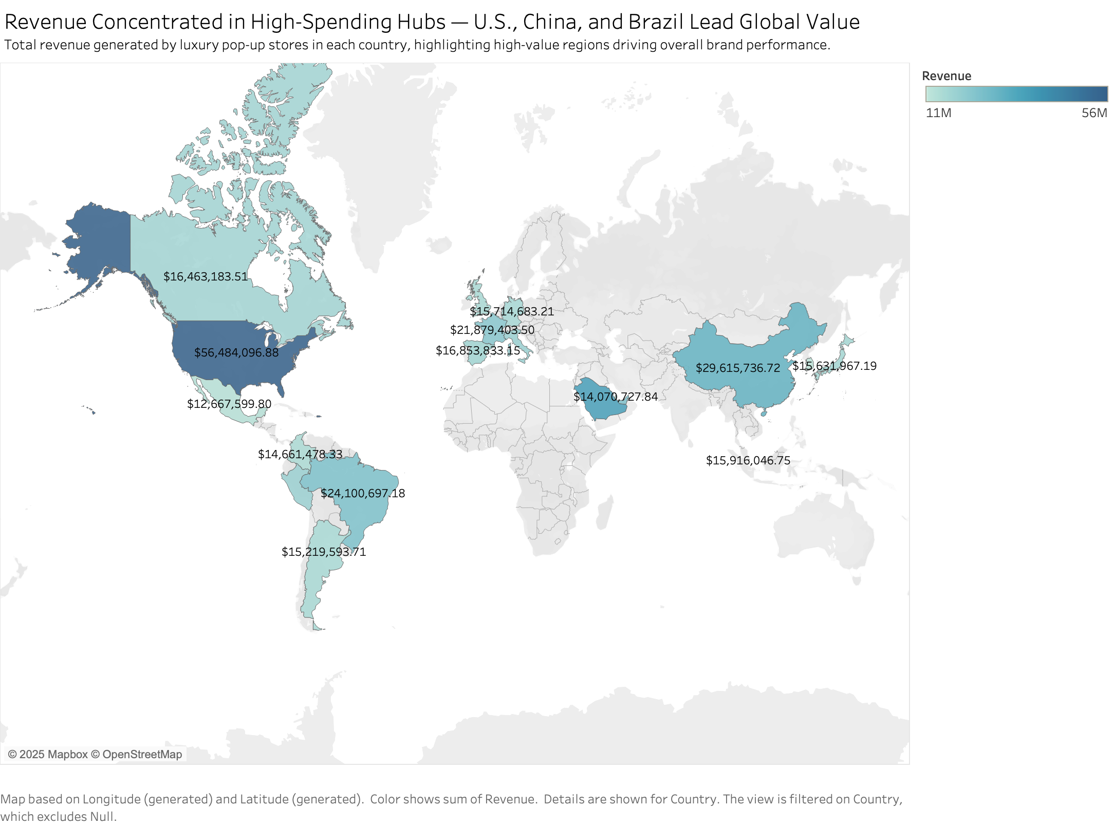
Where?
China: 29.6M
U.S.: 56.5M
Brazil: 24.1M

Slide 9
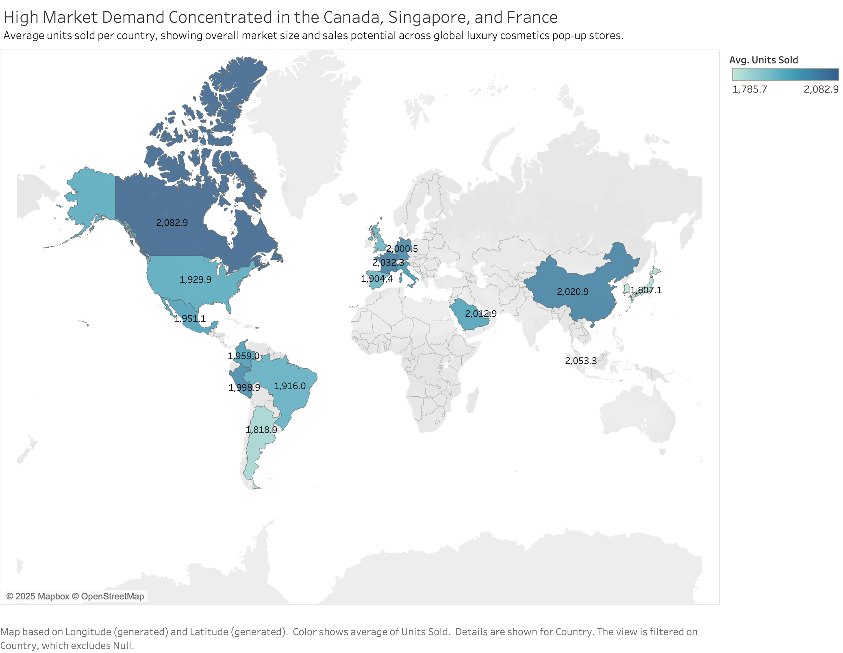
Where?
France: 2032.3
Canada: 2082.9
Singapore: 2053.3

Slide 10
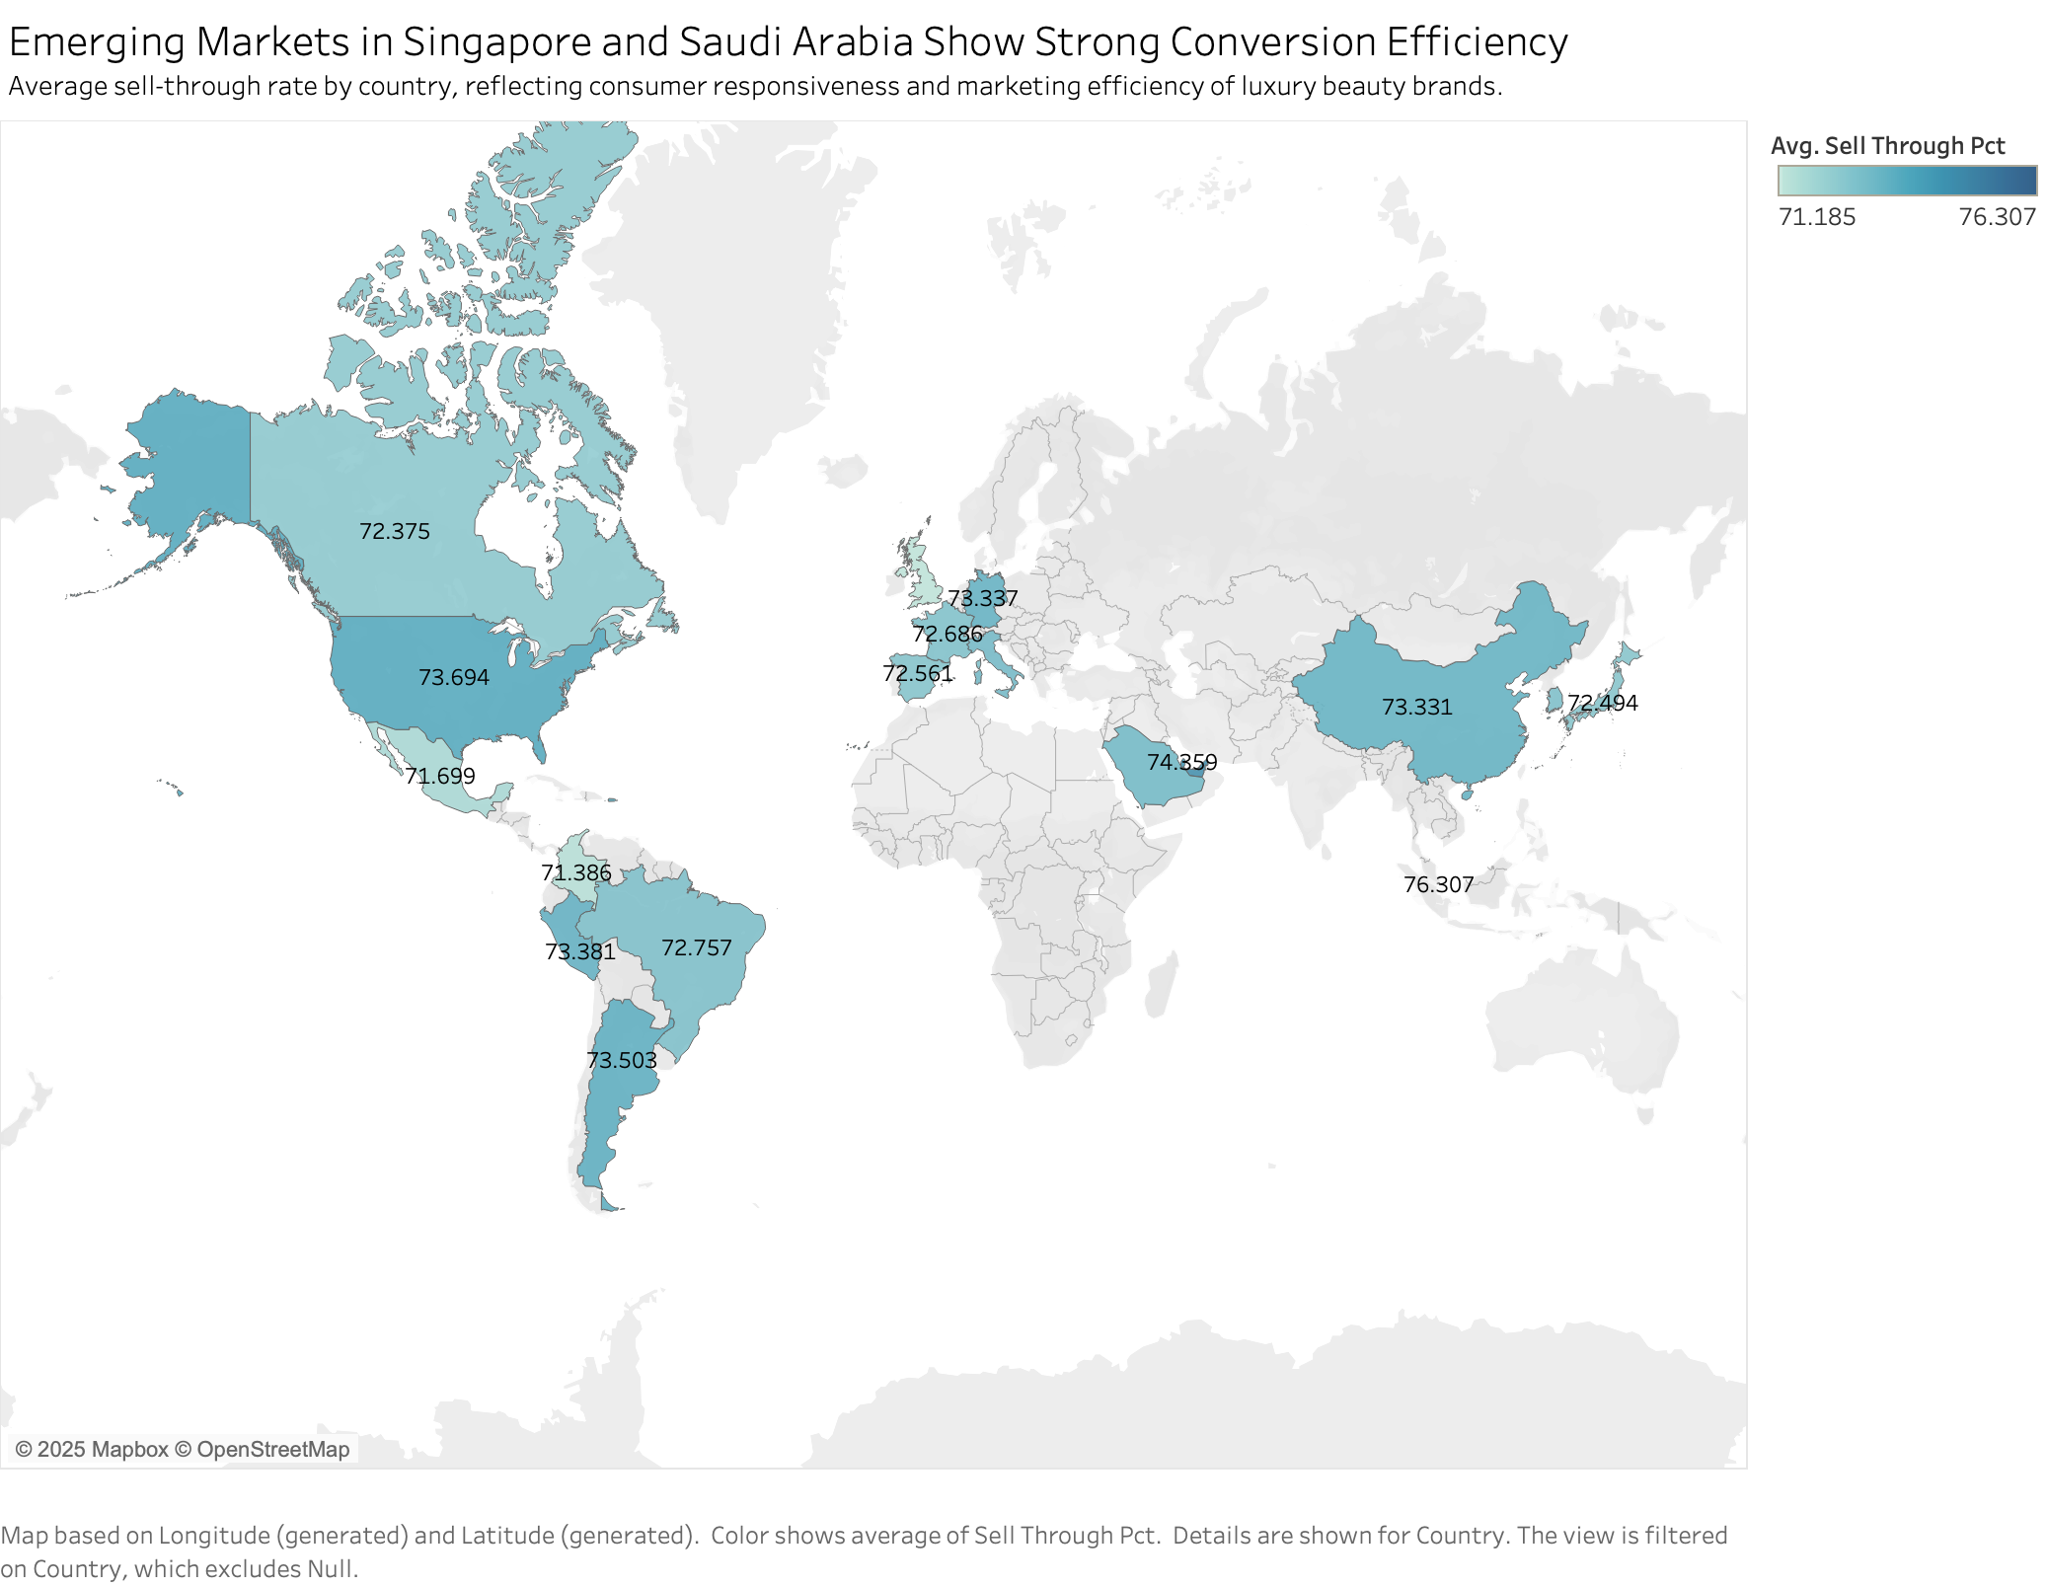
Where?
Saudi Arabia: 74.359
Singapore: 76.307

Slide 11
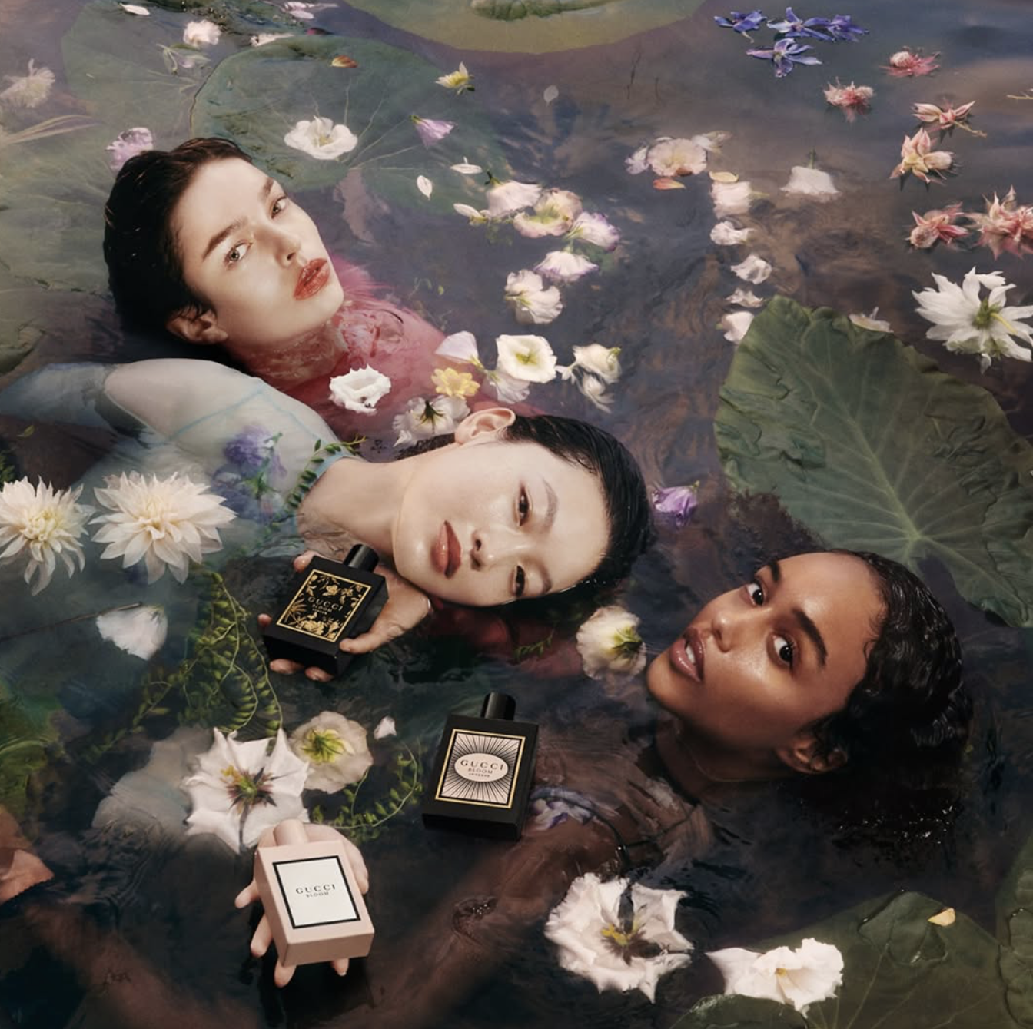
When?
Peak Sales Periods
Seasonal Patterns
Event Alignment
Notes:
Peak Sales Periods: Strongest performance around holidayseasons, Valentine’s Day, and year-end gifting.
Seasonal Patterns: Align pop-ups with Spring/Summer andFall/Winter Fashion Weeks to capture global attention.
Event Alignment: Launch during major beauty events (e.g.,Sephora Sale, beauty expos) and Gucci runway shows for brandsynergy.

Slide 12
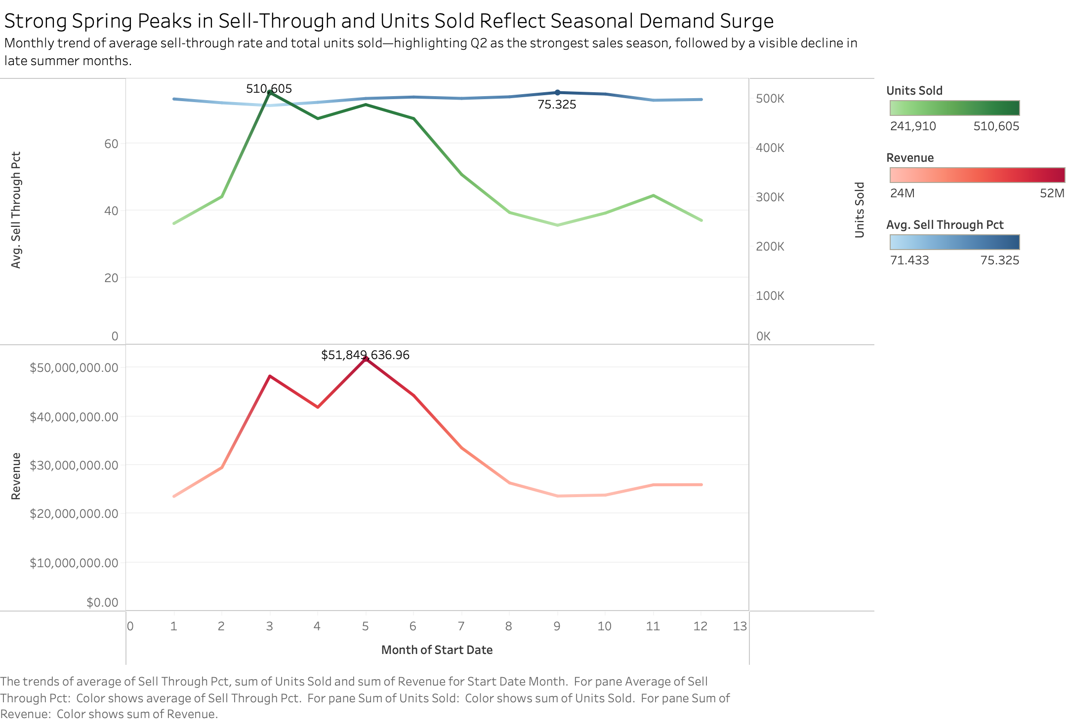
When?
Notes:
Peak sales occur during March–May (spring campaign season), aligning with beauty launches and fashion week cycles. Q3–Q4 shows sales decline, suggesting timing optimization for future pop-ups.

Slide 13
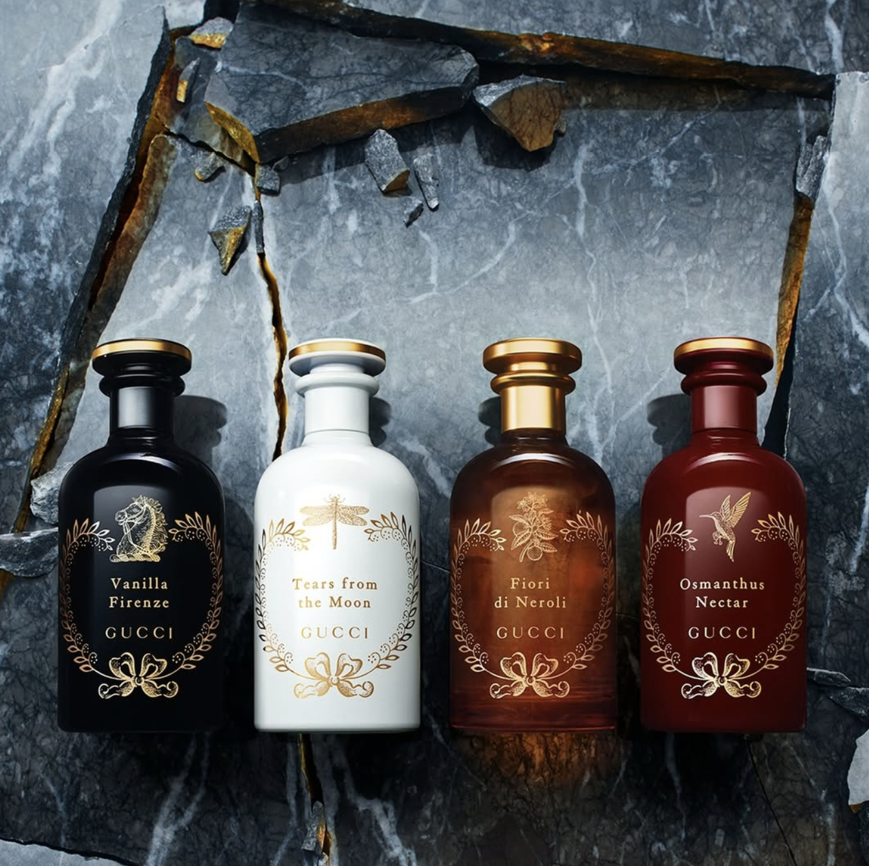
Who?
Top-Performing Models
Scale vs. Efficiency
Trend-Driven Success
Gucci Opportunity
Strategic Goal
Notes:
In this part, we will compare other brands to understand what makes them successful and find where Gucci can position itself in this space.

Slide 14
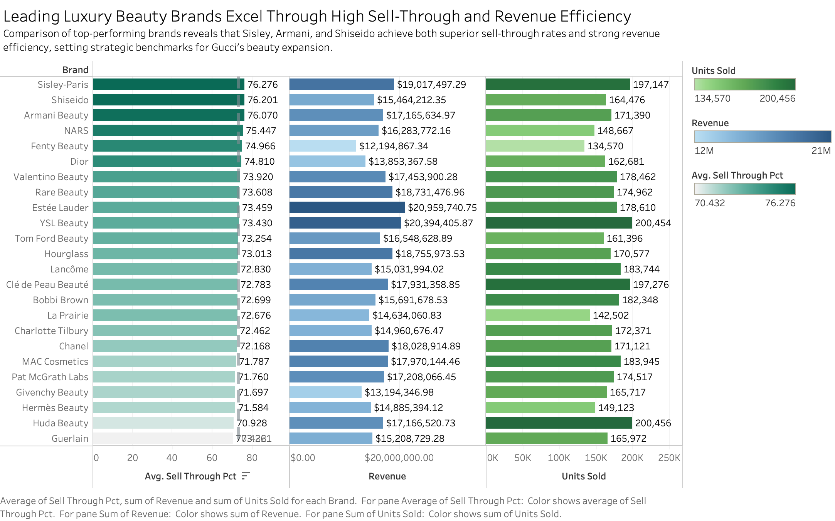
Who?
Notes:
In this chart, we’re comparing top luxury beauty brands based on three key metrics —sell-through rate, revenue, and total units sold.
First, brands like Sisley, Shiseido, and Armani Beauty show the best balance. They have a high sell-through rate. This means their pop-up or retail strategies are both efficient and exclusive.
Second, Estée Lauder and YSL Beauty perform strongly in revenue. These brands rely on strong marketing power and wide distribution, showing that scale can also bring success in the luxury beauty market.
Third, we see brands like Clé de Peau Beauté and Huda Beauty that sell a large number of units but at a more affordable price point. This shows how trend-driven and accessible products can attract younger consumers while still staying in the premium space.
So, Gucci doesn’t need to be the biggest player like Estée Lauder — instead, it can follow the model of Sisley, Shiseido, and Armani, focusing on a premium but approachable position.

Slide 15
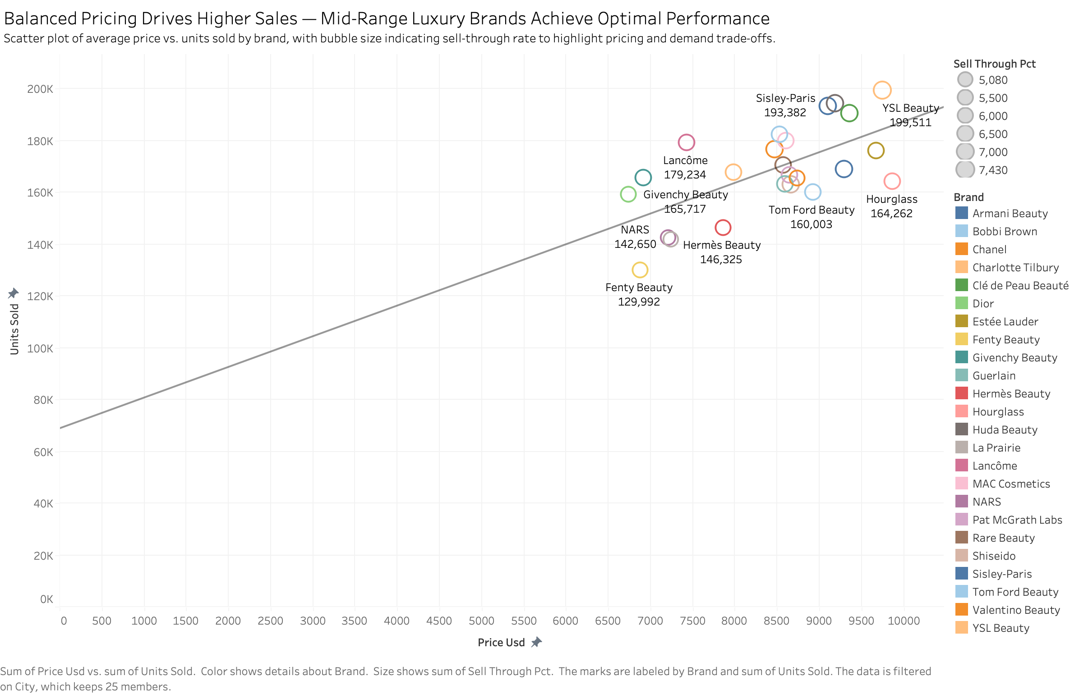
Who?
Notes:
In this chart, we notice here is that most leading brands are grouped around the mid-to-high luxury range, where total prices fall between $8.3K to $9K, and sales volume stays around 160,000 to 190,000 units.
So , Gucci should aim for that premium but approachable zone — maintaining luxury appeal, but making products accessible enough to encourage both trial and repeat purchase.

Slide 16
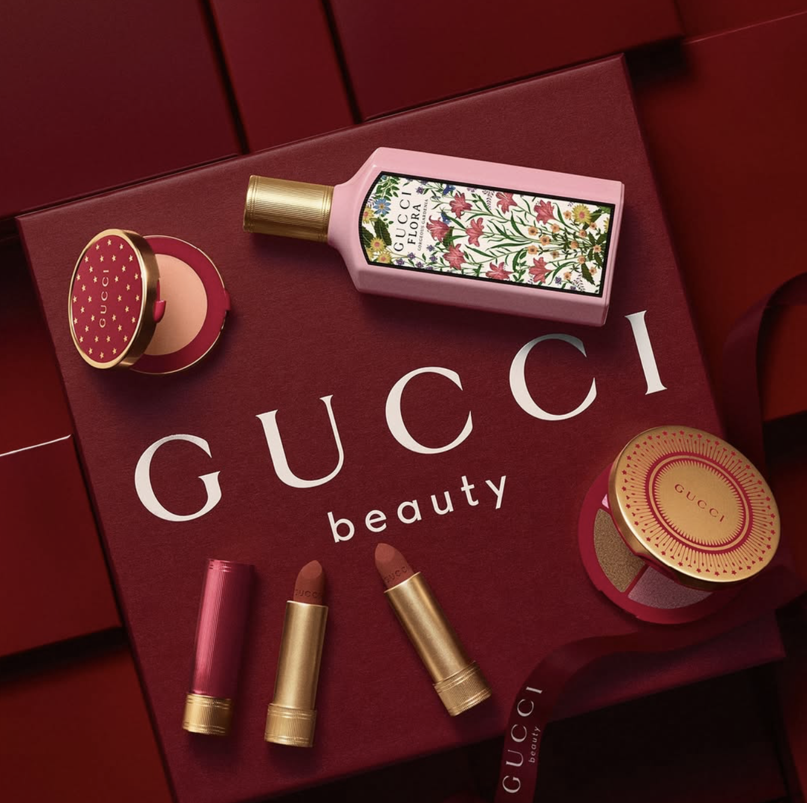
What?
Top Categories
Strategic Role
Entry and Hero Products
Underperforming Categories
Brand Anchors
Notes:
Now, let’s move on to the ‘What’ part of our analysis.
Here, we want to see what types of products are performing the best , and which ones still have room to grow.

Slide 17
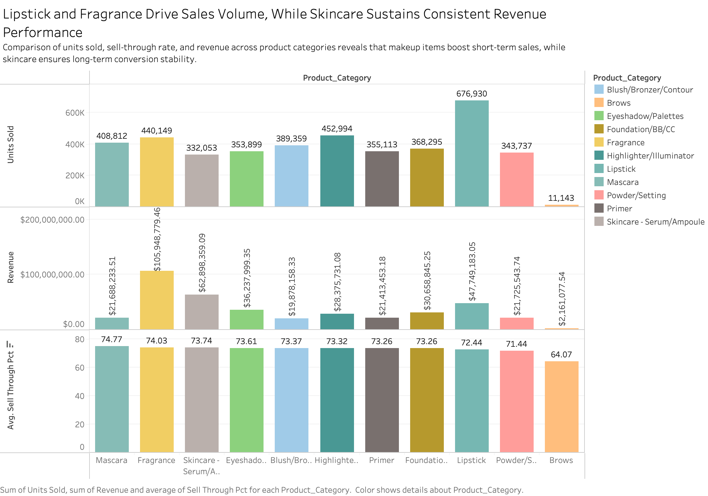
What?
Lipstick: 676,930
Fragrance: 105M
Notes:
From here, we can clearly spot two leading categories — Lipstick and Fragrance. So strategically, Gucci should position Lipstick and Fragrance as its hero and entry categories — using lipstick to attract new customers, and fragrance to strengthen brand love and storytelling.
On the other hand, we can also see some weaker categories, such as brow products and powder. They might represent areas for product improvement.
Finally, Skincare remains important, it helps build long-term brand credibility and customer loyalty.
Together, these findings suggest Gucci can balance immediate sales impact through makeup with long-term brand strength through skincare and fragrance.

Slide 18
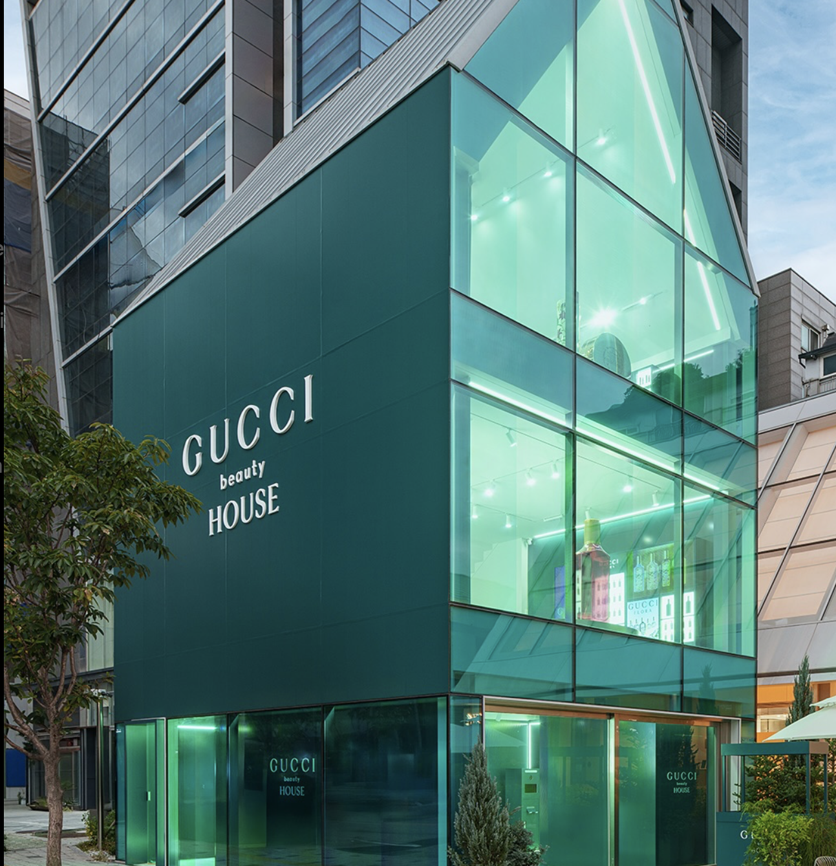
How?
High-Performing Formats
Performance Comparison
Data-Driven Insights
Commercial and Brand Impact
Notes:
Finally, in the “How” section, we explore which pop-up formats generate the best engagement and sell-through to determine what delivers the highest ROI.

Slide 19
High
Flash Event
Mobile
Pop-Up
Truck
Standalone
Pop-Up
Brand
Impact
Shop-in-Shop
Mall Kiosk
Low
High
Cost
Notes:
Now, let’s take a look at the five pop-up formats, and compare them by cost and brand impact.
Starting from the bottom, we have the Mall Kiosk. These are small, semi-permanent booths in shopping malls. They’re good for sampling and steady exposure, but they usually don’t create strong emotional engagement or buzz.
Next, the Mobile Pop-Up Truck. These are traveling experiential trucks that literally bring Gucci to the streets — appearing in outdoor plazas, music festivals, or city centers. They’re flexible, eye-catching, and great for social media engagement, making them a strong fit for younger audiences or new market entry.
Moving right, we have the Shop-in-Shop format. This places Gucci Beauty inside department stores, keeping the brand identity but using existing foot traffic. It’s more efficient for long-term sales, but it’s less exclusive or experiential compared to real pop-ups.
Then, Flash Events — one of the top performers in brand impact. Flash Events are short-term activations that create big excitement in a short time. They’re perfect for limited launches, seasonal campaigns, or collaborations that need a quick boost in attention.
Finally, the Standalone Pop-Up Store. These are fully branded temporary stores, often open for a few weeks or months. They require a higher investment, but they deliver the deepest luxury experience — helping build storytelling, emotional connection, and premium brand image.
So, in short: Flash Events are best for impact, Standalone Pop-Ups are best for image, and Mobile Trucks are best for reach and engagement.
A balanced mix of these three formats would help Gucci maximize both awareness and conversion — creating excitement, expanding reach, and strengthening its luxury presence at the same time.

Slide 20
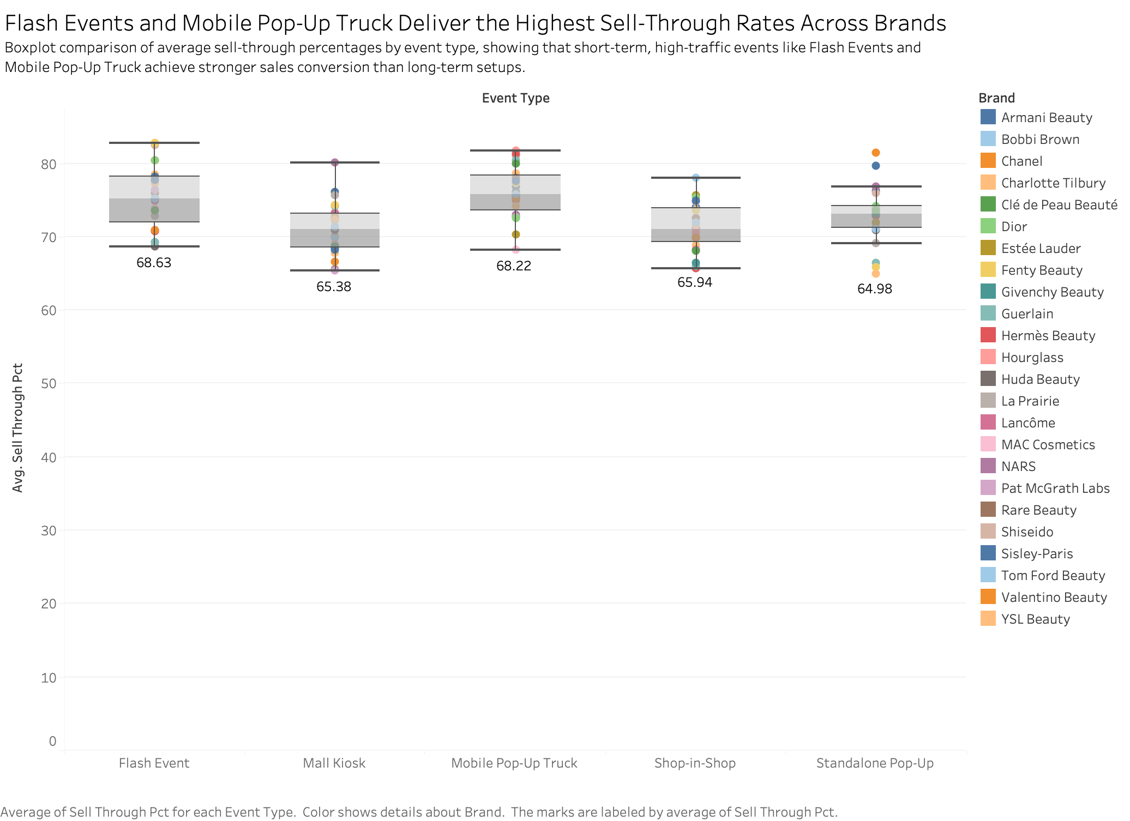
How?
Notes:
From this chart, we can see that two formats really stand out — Flash Events and Mobile Pop-Up Trucks.
Both have the highest average sell-through, around 68%, which means they convert more visitors into actual buyers.
For Gucci Beauty, Flash Events are perfect for limited-edition lipstick launches, fragrance debuts, or seasonal campaigns. They build quick buzz, spark purchases, and perfectly fit Gucci’s image of luxury with energy.
Meanwhile, Mobile Pop-Up Trucks bring the brand outside traditional retail zones — into urban centers, fashion streets, and festivals. They work like a traveling “Gucci Beauty Roadshow,” where customers can try makeup, experience scents, and share the moment on social media.
So together, these two formats — Flash Events and Mobile Pop-Ups — create the perfect balance for Gucci.

Slide 21
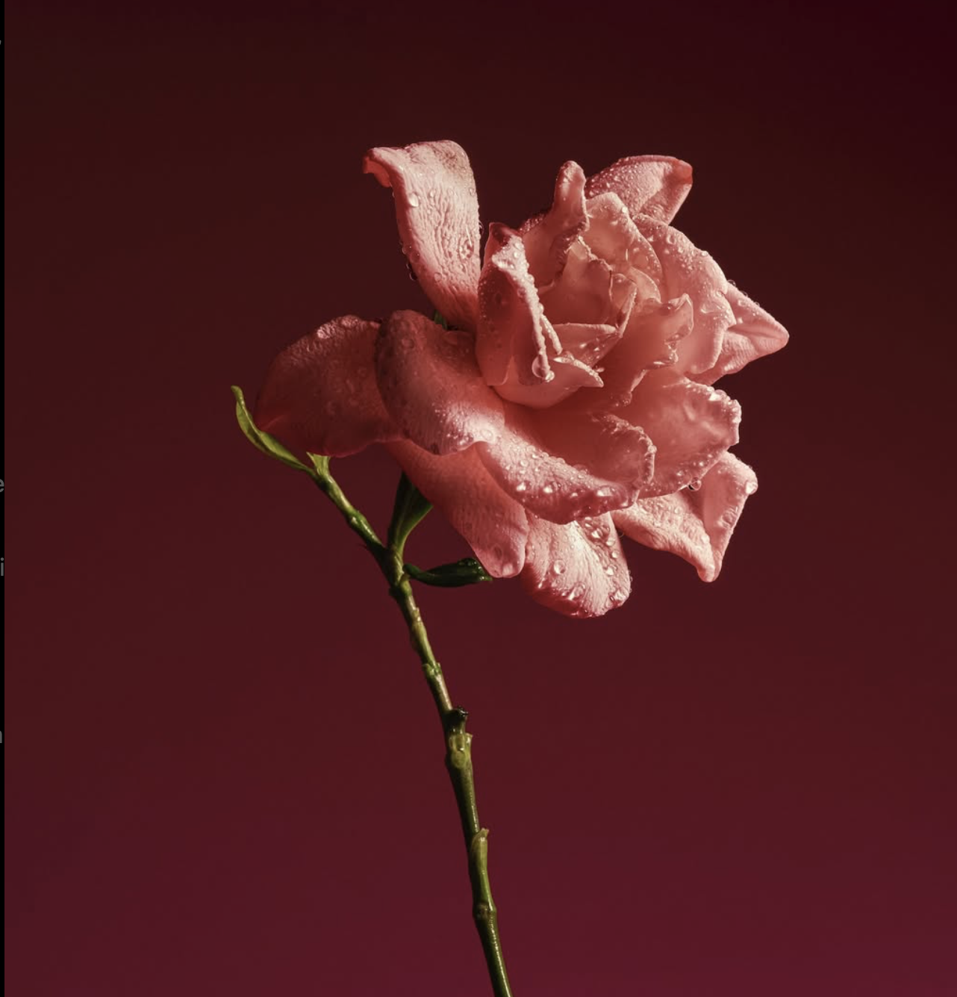
Summary
Beauty = Brand Gateway
North America and Asia
Spring / Holiday peaks
Premium Benchmarks
Lipstick and Fragrance Lead
Flash and Mobile Pop-Ups

Slide 22
Gucci Pop-up Cosmetics Expansion Analysis A 5W1H Strategic Framework
Marketing Team
Karina Hsu, Shloka Patade
Contact: marketing@gucci.com
Marketing Team
Karina Hsu

